Slide 1

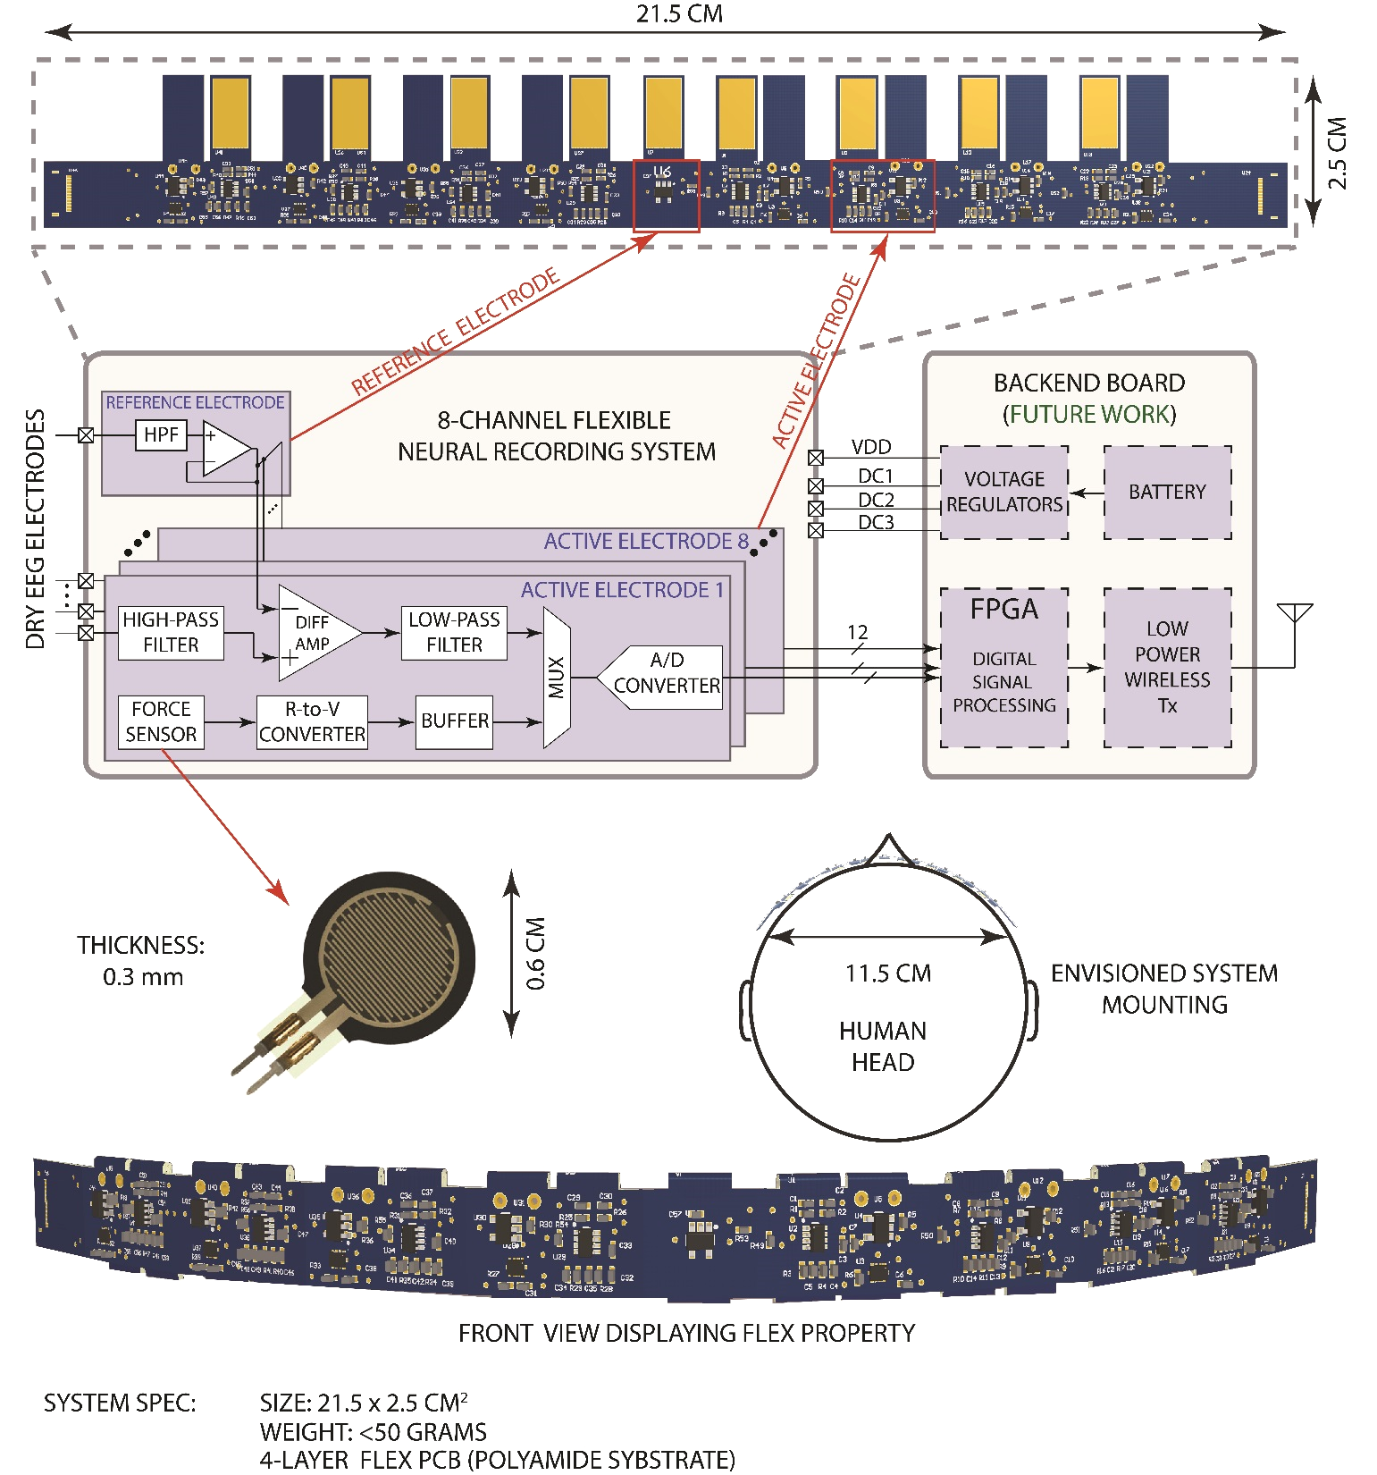
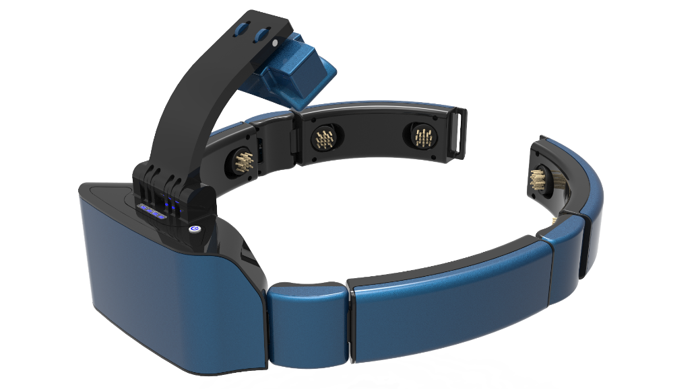
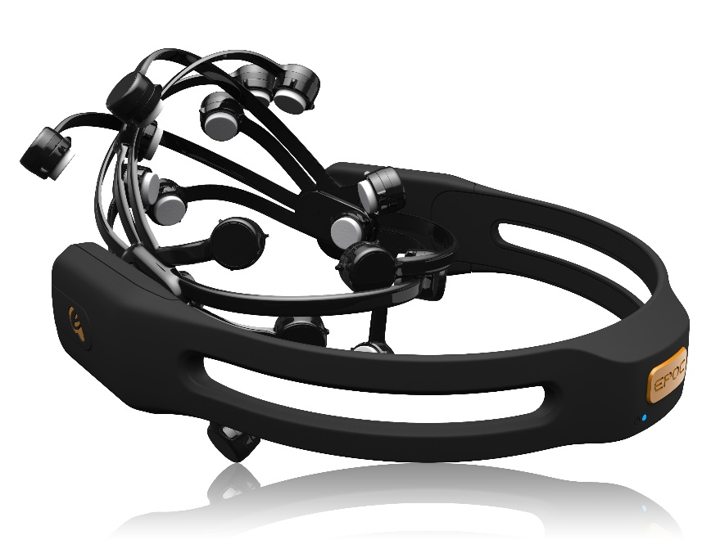
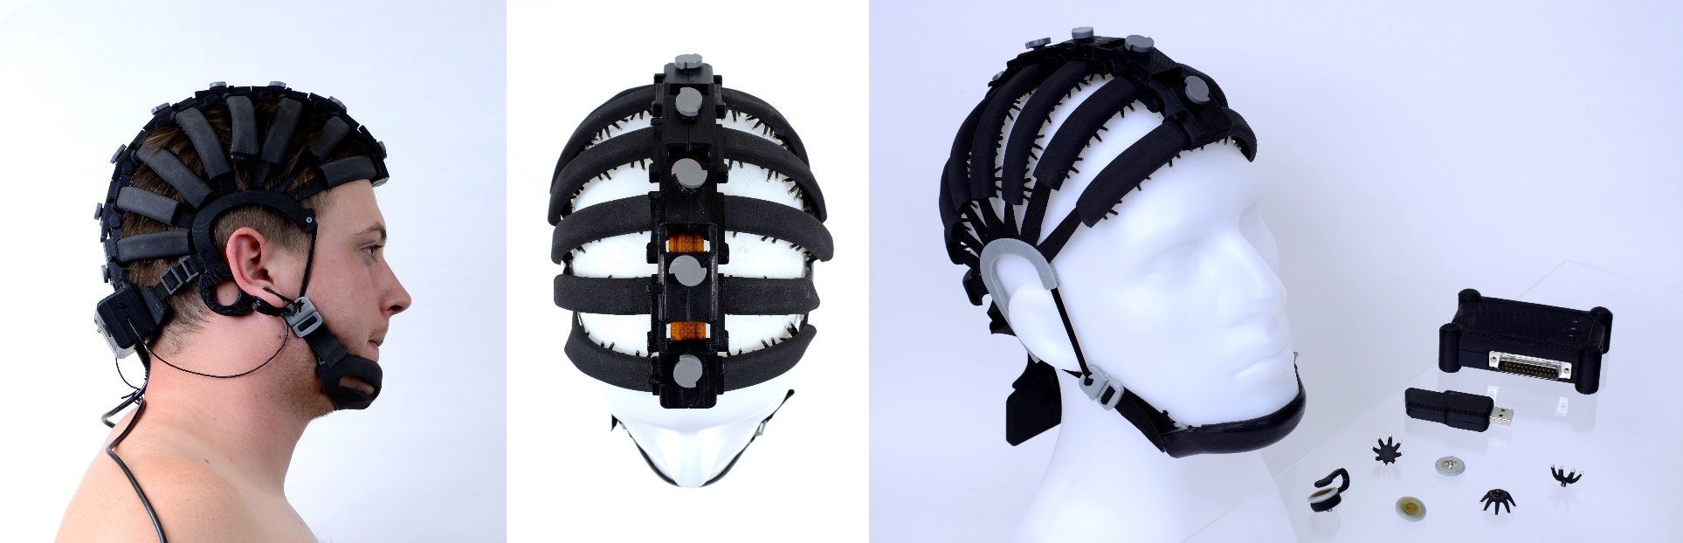
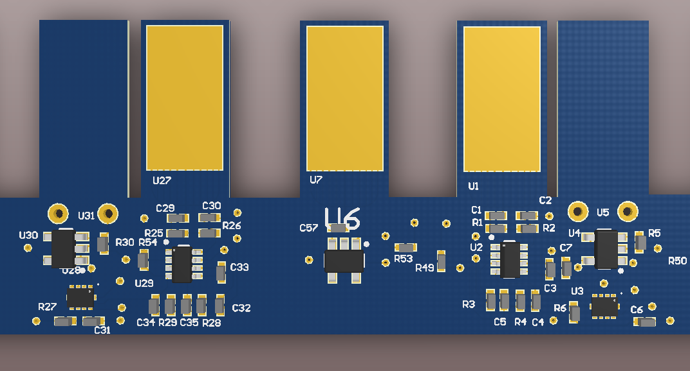
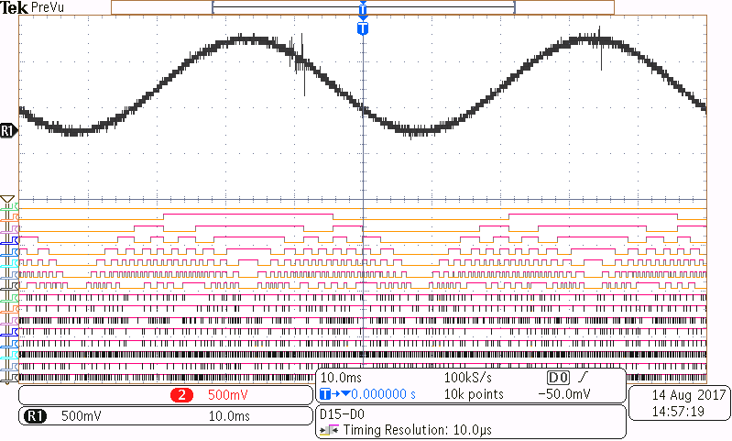
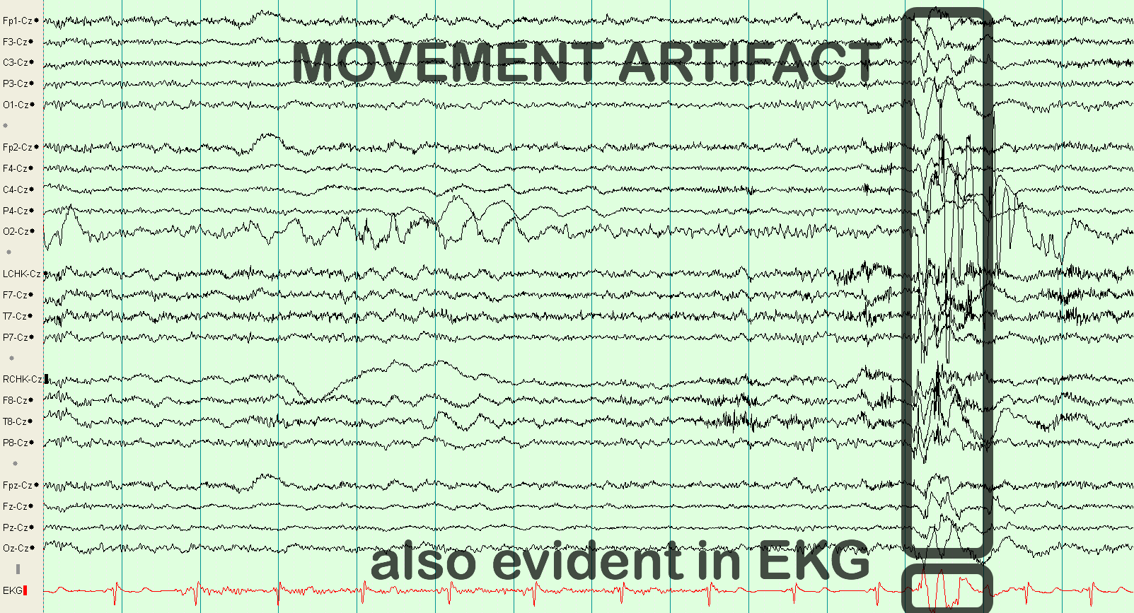


An 8-Channel Flexible Dry Active-Electrode System for Neural Monitoring and Motion Artifact Detection
SAM GURAYA, HOSSEIN KASSIRI
Department of Electrical Engineering and Computer Science, York University
Motivation
Develop a wearable brain neural monitoring system.
The device will be used for monitoring and diagnostic applications.
The presented device is designed to be accompanied by a module for
  Signal processing
  Wireless data communication
2. Design Challenges:
3. Electrode Considerations
Dry Electrodes:
Do not involve using any gels → Fast setup
Easy integration for portable designs → self-contained + low-cost
More convenient and comfortable than wet electrodes.
Contact not as good as wet electrodes.
Flexible Circuit:
Adjusts to the skull curvature
Light weight.
Allows to improve electrode-skin contact .
with spring-like mechanical design.
Active Electrodes:
Remove the wire between electrode pads and amplifier inputs.
Decreases risk of noise being coupled.
No signal attenuation at the input
Allows for active shielding.
5. System-Level Design
6. Circuit-Level Design
7. Results
Skin
Shield
+
Amplifier
Active Shielding Module:
Blocks capacitive coupling of analog/digital signals of active electrode to the electrode plate.
Biased by output of amplifier to protect signal input.
-
Avertus Emotiv Cognionics
Application Level
Comfortable to use
Fast setup
Light weight
Low-cost
Self-contained
System Level
Multiple channels
Long battery life
Fully wireless
Differential Recording
Circuit Level
BW: 0.1- 500 Hz
EEG Amp.: 10uV to 1mV
High CMRR/PSRR
Low noise(<100nV/sqrt(Hz)
Resolutions >10 bits
Gain vs frequency plot showing gain to be 650 V/V.
Sine input amplitude is 1mV
Common input signal used is a sine wave at 100 mV amplitude.
In a voltage divider configuration,
3.3V was applied.
Electrode
C₁
R₁
R₂
ACTIVE ELECTRODE DESIGN.
VDD/2
R_{G}
LMV641
Digital
Output
Reference Electrode
C₁
R₁
C₂
MUX
ADS1018
VDD
+
Sampled 20Hz signal and digital output of the ADC.
4. Motion Artifact Removal
Large artifacts could be generated due to the poor skin contact with dry electrodes.
The contact quality can be quantified using a force sensor between the electrode and the skin.
This information could be used to compensate the effect of artifacts in the digital backend.
Force Sensor
10K
MCP6V31
8. Impact/Contributions
A point-of-care low-cost wearable EEG recording system can improve personalized for both monitoring and diagnosis applications.
The device yields smallest form factor, lightest weight compared to the commercially-available products.
Future additions to the device will include features such as fully wireless operation, and embedded signal processing for neurological event detection (e.g. epilepsy seizures).
-
Circuit implementation for proposed active electrode.
Motion artifacts have larger amplitudes and usually start and end quickly.
eegatlas-online.com
Gain:$G=1+\frac{49.7kΩ}{R_{G}}$High Pass Pole: $f_{HP}=\frac{1}{2πR_{1}C_{1}}$Low Pass Pole: $f_{LP}=\frac{1}{2πR_{2}C_{2}}$
Formulas used to control gain, and bandwidth of bandpass filter.

